Slide 1

Building a Stock Portfolio Web App: Frontend & Backend with JavaScript and MySQL
A technical overview of the full-stack architecture, detailing the role of HTML, CSS, JavaScript, and MySQL in creating a secure and interactive financial management application.

Slide 2




Project Overview: What We’re Building
Full-Stack Website
Core Functionality
Data Visualization
A complete stock portfolio management application built from the ground up.
Includes user registration, login, and key transaction features like buy, sell, invest, and withdraw.
Real-time visualization of portfolio balance and transaction history using dynamic graphs.
Technology Stack: HTML, CSS, JavaScript (Frontend & Backend), and MySQL for data persistence.

Slide 3
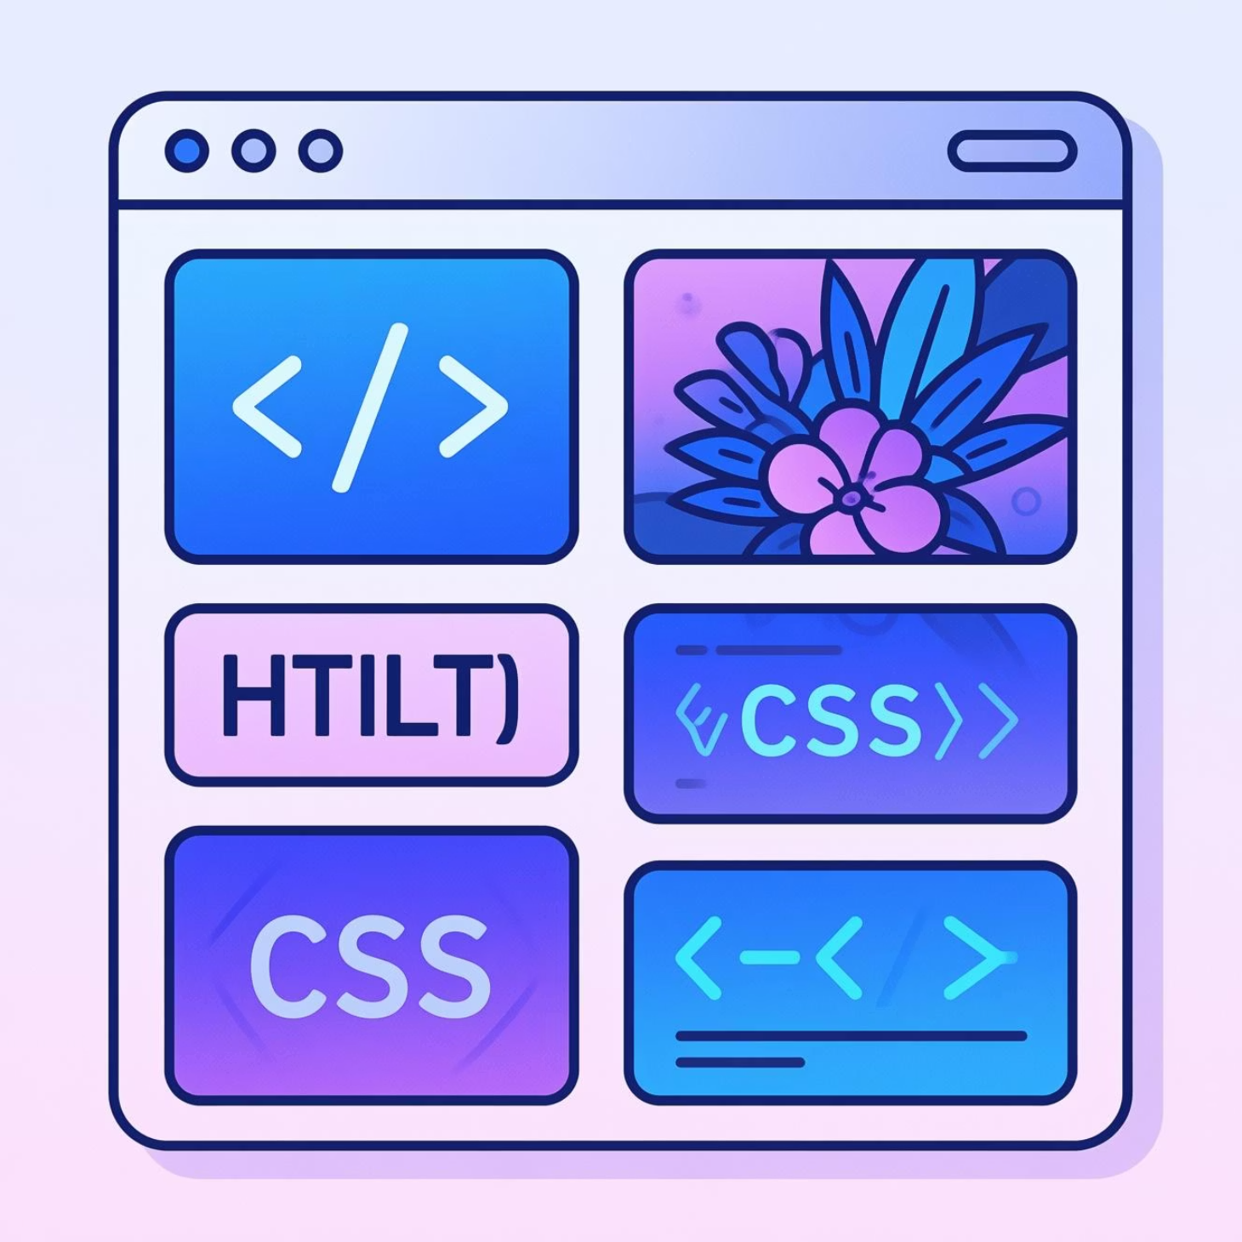
Frontend Structure: HTML & CSS for UI
HTML: Provides the semantic foundation for all pages (registration, login, dashboard, transactions).
CSS: Ensures responsive and clean design using Flexbox and Grid layouts, crucial for a professional user experience.
JavaScript: Handles DOM manipulation, client-side form validation, and dynamic content rendering, bringing the interface to life.
The frontend is designed to be intuitive, ensuring users can navigate their portfolio effortlessly.

Slide 4
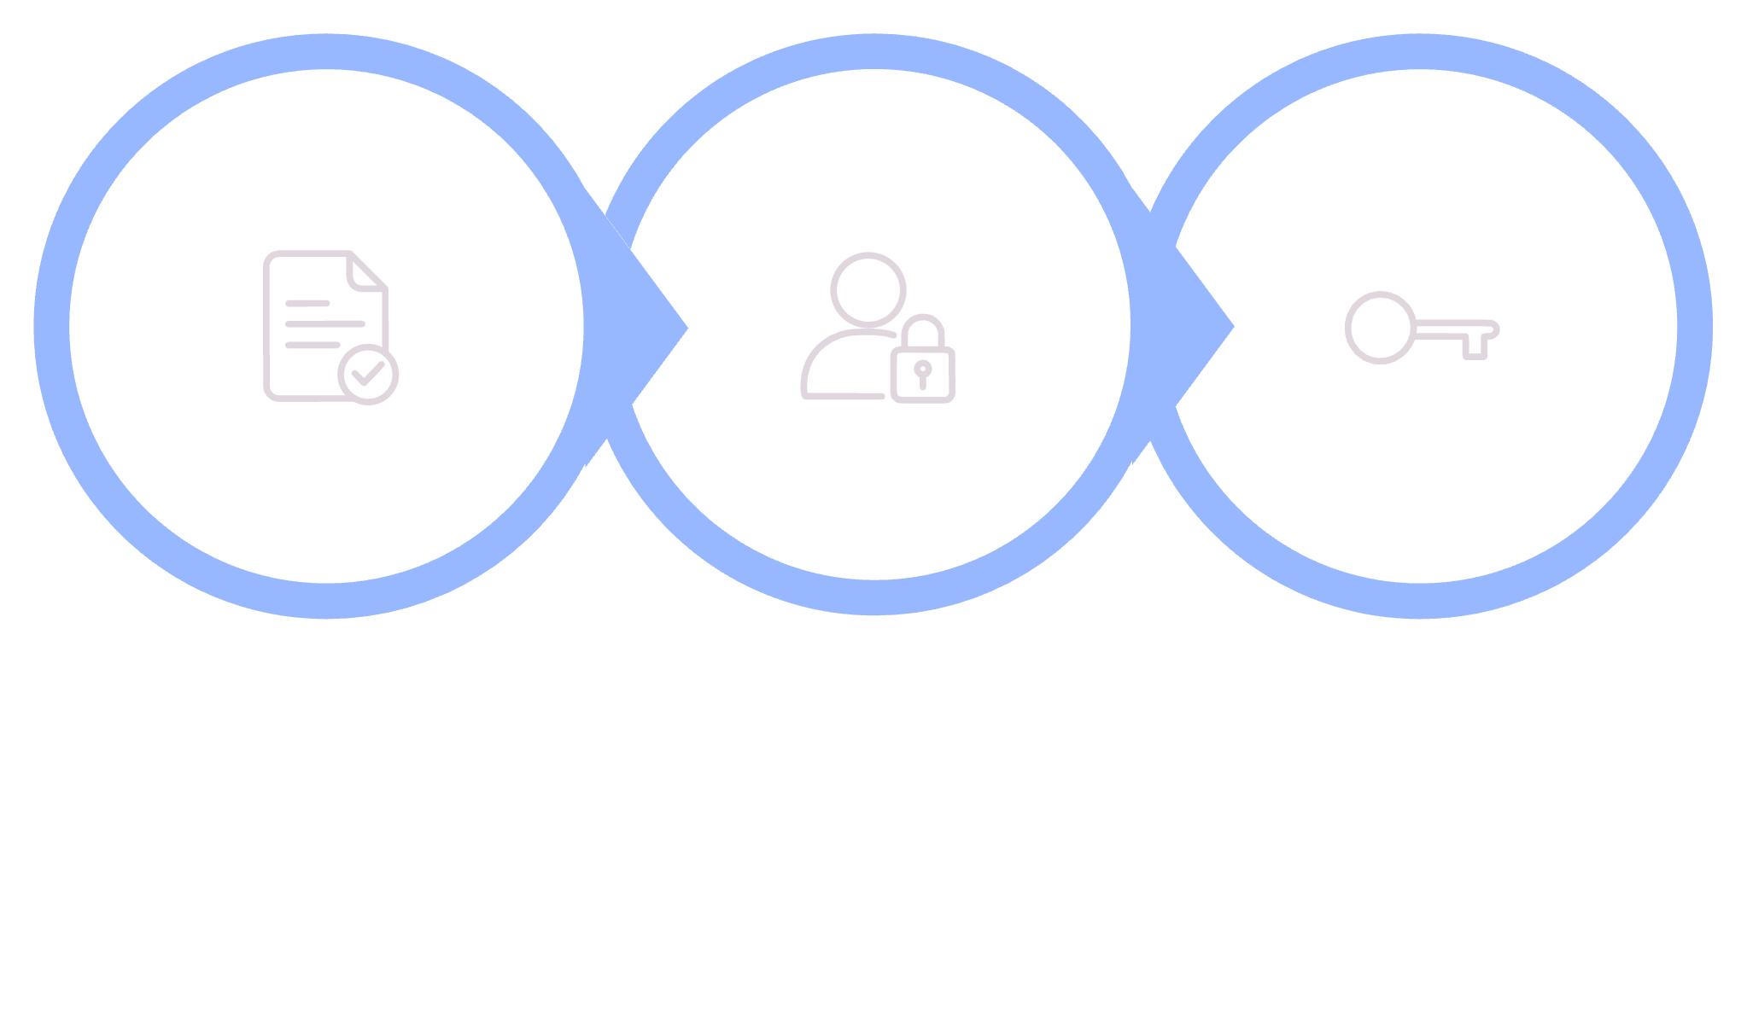




User Authentication Flow: Securing Access
Frontend Register
Backend Hashing
Login Session
Registration & Validation
Password Security
Login & State Management
Collect and validate user inputs (username, email, password) directly on the client side using JavaScript.
Crucially, the backend hashes the password before storage in the MySQL database.
Upon successful login, session management (e.g., using JWTs or cookies) is initiated to maintain the user's authenticated state.

Slide 5
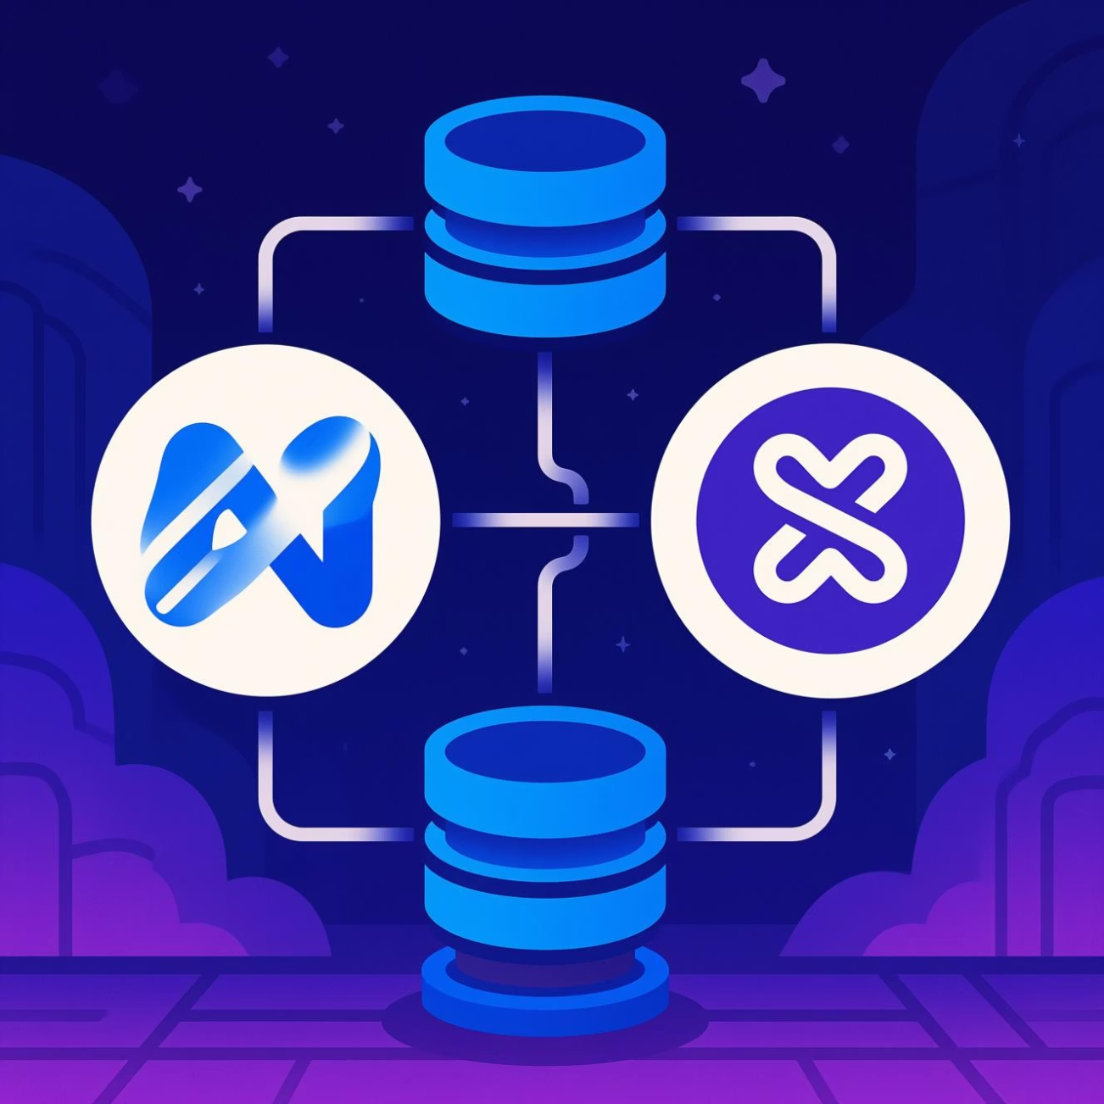


Backend Integration: JavaScript & MySQL Core
The backend leverages Node.js with Express.js to create a robust and scalable server environment.
Server Framework
Database Storage
Express.js handles API routing and middleware functions efficiently.
MySQL persists all critical data: user profiles, transaction history, and stock holdings.
RESTful Endpoints
Clearly defined routes like /register, /buy, and /portfolio manage application logic.
Example: A POST /buy route atomically updates the user's cash balance and logs the transaction in the MySQL tables.

Slide 6
Managing Transactions & Portfolio Data
Every user action initiates a validated transaction cycle on the backend, ensuring data integrity.
Frontend Request
1
User submits buy/sell requests with stock symbol and quantity.
2
Balance Validation
Backend checks current funds or holdings for sufficient balance.
Database Update
3
MySQL tables (transactions and portfolio holdings) are updated in real-time.
4
Cash Management
Separate functions track investment and withdrawal actions, updating the primary cash balance.
History Tracking
5
All movements are logged with timestamps for a complete audit trail.

Slide 7

Visualizing Portfolio Performance
Data retrieved from the MySQL database is transformed into actionable visualizations using powerful JavaScript libraries.
Charting Libraries: Tools like Chart.js or D3.js are integrated into the frontend to render complex financial data.
Graph Types: We display transaction history, stock value trends, and total portfolio balance over time.
Dynamic Updates: Charts are designed to refresh immediately after any transaction, providing a seamless, real-time experience.
A line chart can show portfolio value growth, a crucial metric for investors.

Slide 8






Code Architecture Highlights: The MVC Pattern
Employing the Model-View-Controller (MVC) pattern ensures organized, scalable, and maintainable code structure.
Controller (Express.js)
Handles all business logic, processes requests, and interacts with both the Model and the View.
Model (MySQL)
Manages data storage: Database schema for users, stocks, and transactions.
View (HTML/CSS/JS)
The user interface layer; dynamic rendering based on data from the Controller.
This separation of concerns significantly improves development speed and long-term product health.

Slide 9







Security & User Experience Considerations
Robust Security
Implement password hashing (e.g., bcrypt) to protect user credentials.
Data Protection
Mandatory input sanitization to prevent common vulnerabilities like SQL injection and XSS attacks.
Responsive Design
Ensure optimal usability across all device types, from desktop monitors to mobile phones.
Smooth User Experience (UX)
Utilize asynchronous JavaScript (AJAX/fetch) for quick, non-blocking updates, enhancing performance.

Slide 10
Summary & Next Steps
Interactive App
1
Successful creation of a secure, interactive stock portfolio application using full-stack JavaScript and MySQL.
Core Takeaways
2
Mastered user authentication, transactional consistency, and dynamic data visualization.
Future Enhancements
3
Integration of real-time stock market APIs, user notifications, and mobile app compatibility.
Ready to build your own? Start with small modules and iterate!

Slide 11
Thank You
Done BY:
S. Dhanush
K. Harshith
Praveen Naik
Roop Singh

